Slide 1
PocketPath
GROUP 8 | LLM PRODUCT DEVELOPMENT LAB
See where the small stuff goes.
Notes:
We are Group 8. Our brief was the budget-challenged student, and our product is called Pocket Path.

Slide 2
The problem
Students overspend on things too small to feel worth tracking.
WHERE IT GOES, EVERY DAY
Food
Transport
Coffee
Subscriptions
Shopping
Printing
Social
Notes:
Each of these purchases feels minor, so nobody tracks them. Together they add up, and students lose sight of where their money goes. Existing budgeting apps are built for salaries and bills, so they feel like homework.

Slide 3
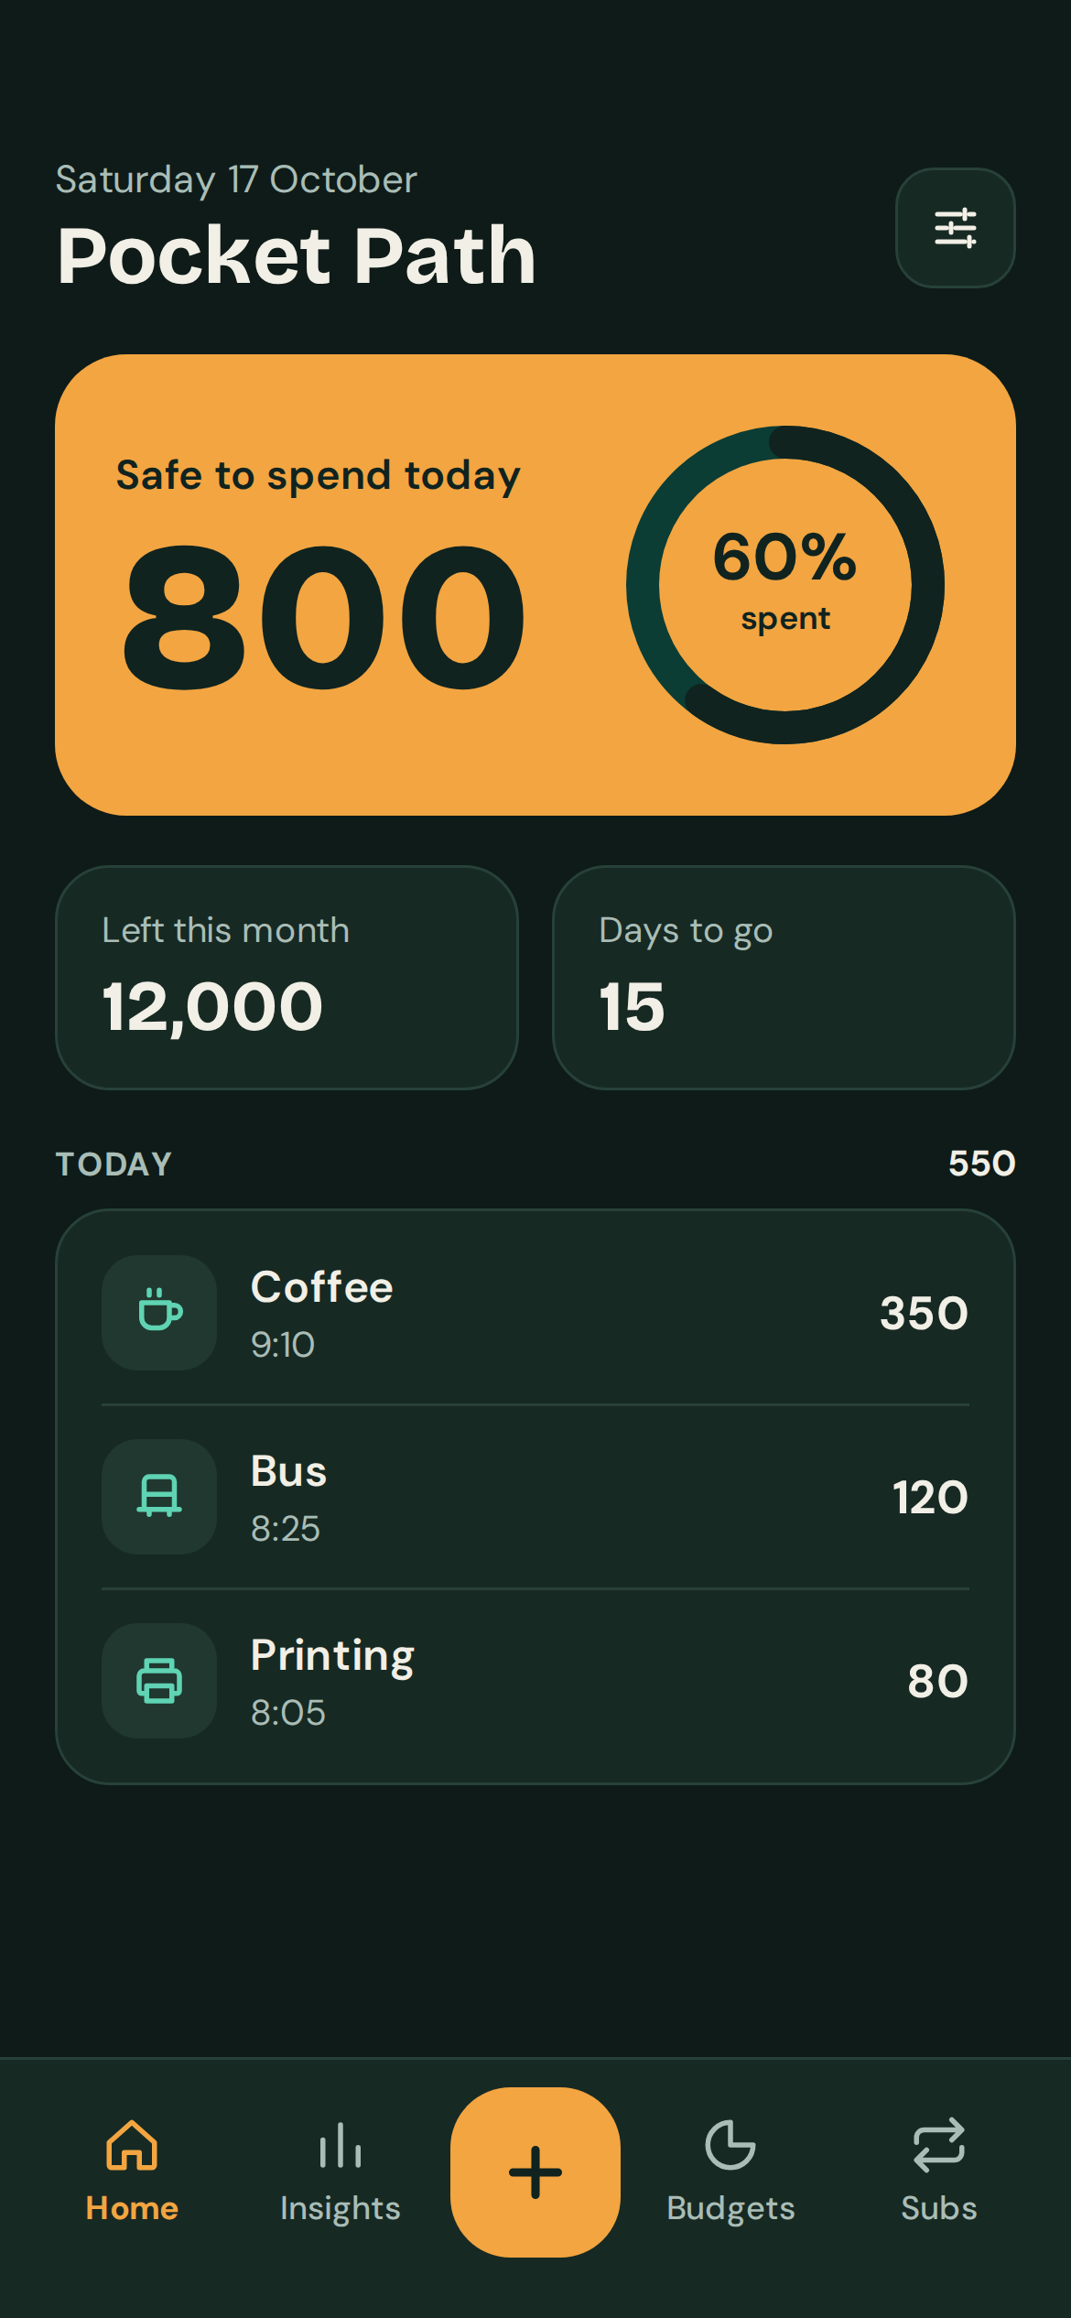
The product
A mobile app that makes logging a small purchase take under five seconds, then shows how those purchases add up.
TARGET USER
A first-year student living away from home on a fixed monthly allowance, who has never budgeted and runs short in the last week of the month.
Notes:
Pocket Path answers one question every day: how much can I safely spend today? On the right is our home screen with sample numbers. Our target user is a first-year student on a fixed allowance who has never budgeted before.

Slide 4
How a student uses Pocket Path
POCKET PATH UPDATES
Home
safe to spend today
STEP 1
STEP 2
STEP 3
Make a purchase
cash or card
Open Quick add
amount + category
Expense saved
stored on the phone
Insights
totals by category
Budgets
warning near the limit
Notes:
Using Pocket Path takes three steps: make a purchase, open quick add, and save the expense with an amount and a category. Pocket Path then updates the home screen, the insights and the budget warnings automatically.

Slide 5
The features
UNDERSTAND
CONTROL
MANAGE
Where does my money go?
How much can I spend?
What keeps recurring?
Quick add
Safe to spend today
Subscription tracker
Amount, one tap on a category, done. Works for cash too.
One daily figure that updates with every purchase.
Every recurring payment, its next billing date and the monthly total in one list.
Small-stuff insights
Category budgets
Scattered purchases become one clear total per habit.
Monthly limits with a warning as you get close.
Notes:
The brief asked us to help students understand, control and manage their spending, so we built the features around those three words. Quick add and insights help them understand. The daily safe-to-spend figure and category budgets help them control. The subscription tracker helps them manage over time.

Slide 6
How the safe-to-spend figure is calculated
Monthly allowance
Spent so far
Money left
Days left
Safe to spend today
−
=
÷
=
30,000
18,000
12,000
15
800
Example values only, shown without a currency. The figure is recalculated after every purchase.
Notes:
The safe-to-spend figure is simple. Take the monthly allowance, subtract what has been spent, and divide what is left by the days remaining. In this example a student with 12,000 left and 15 days to go can spend 800 today.

Slide 7
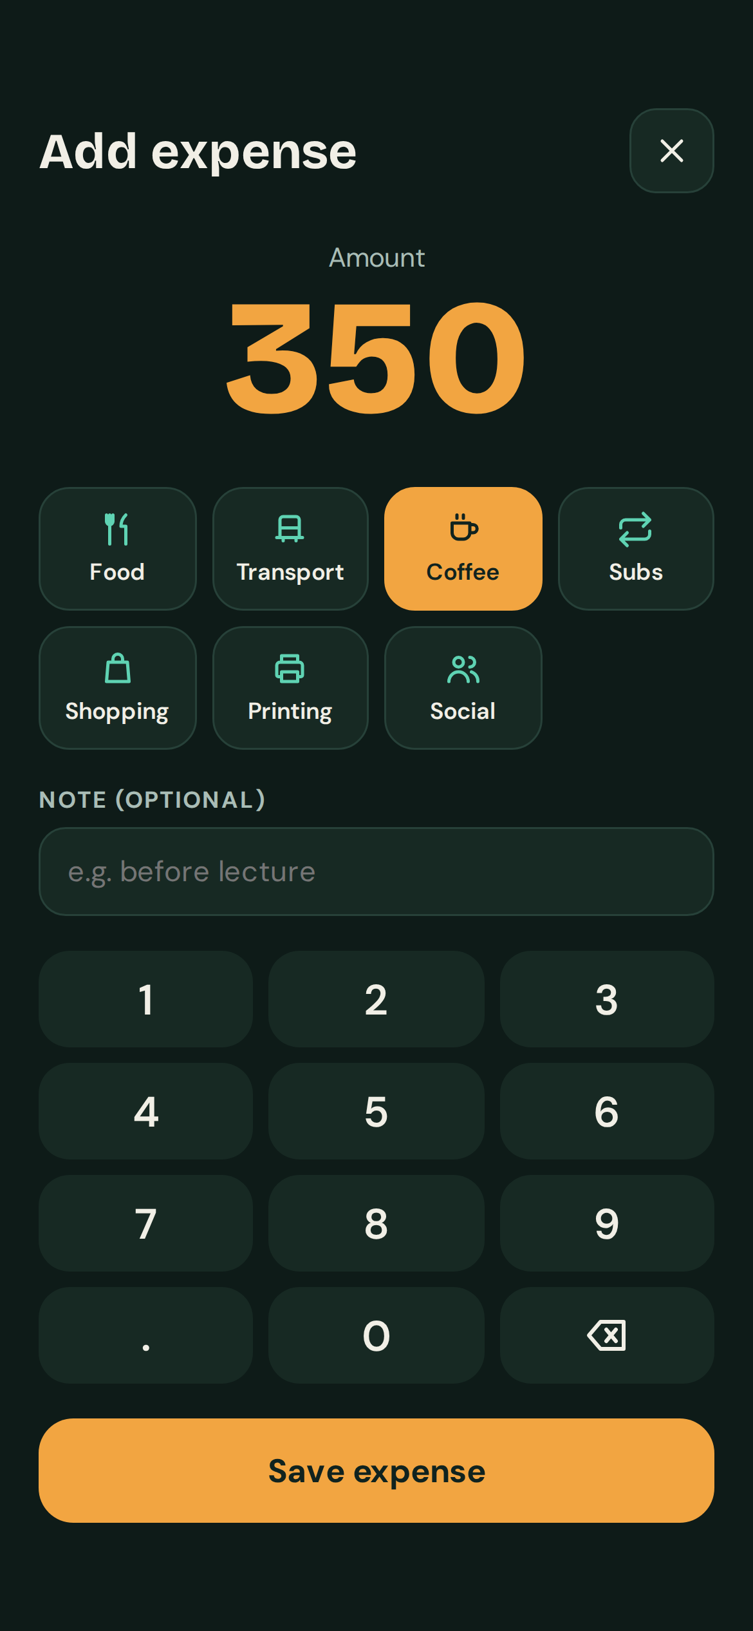
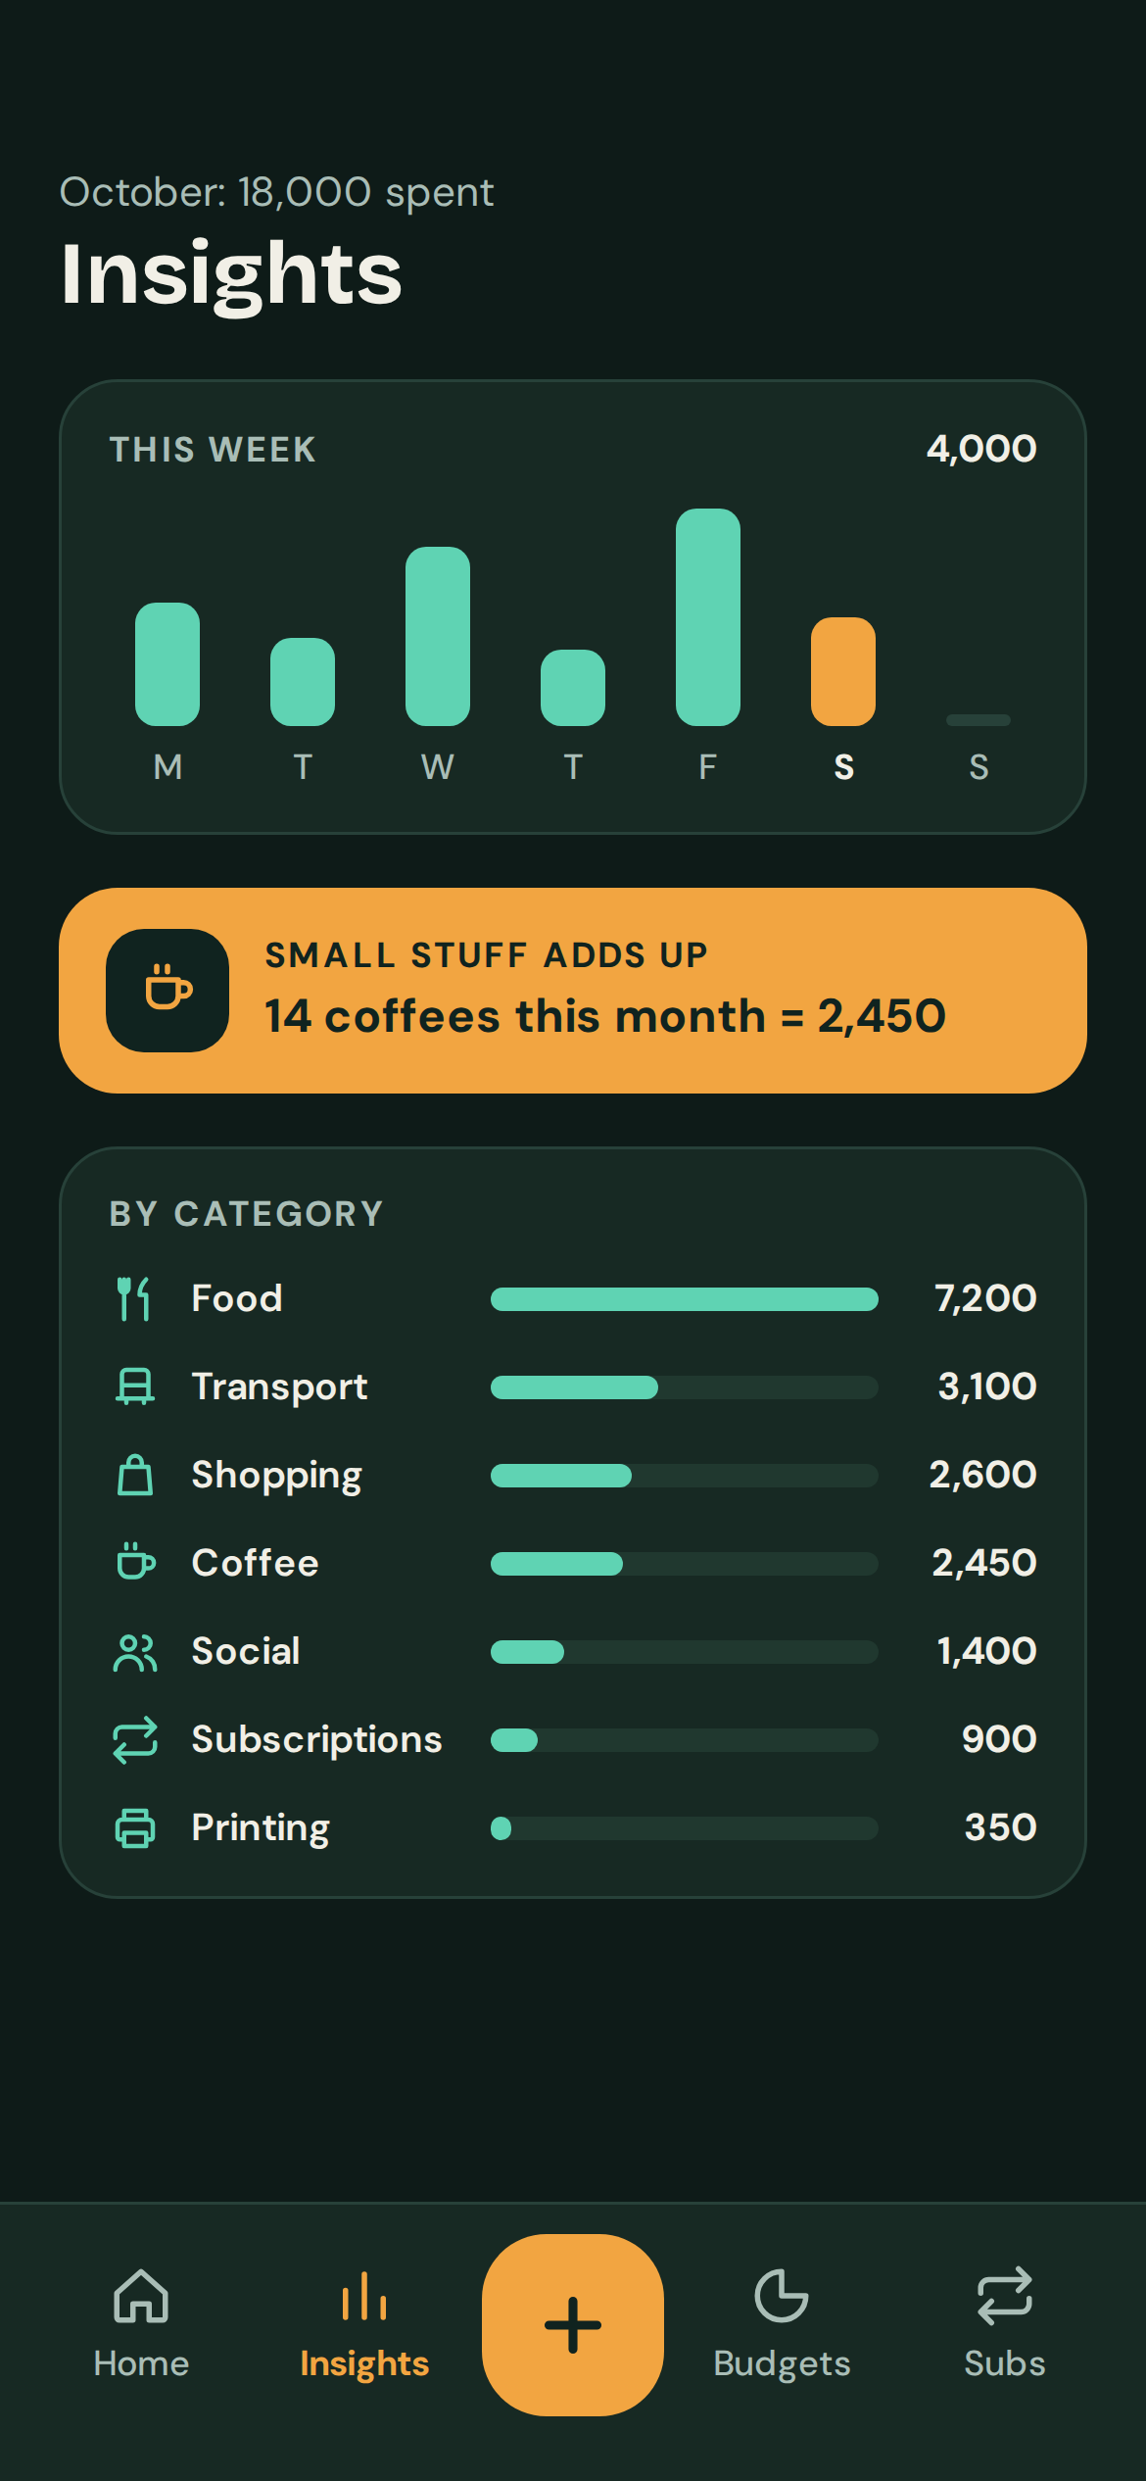
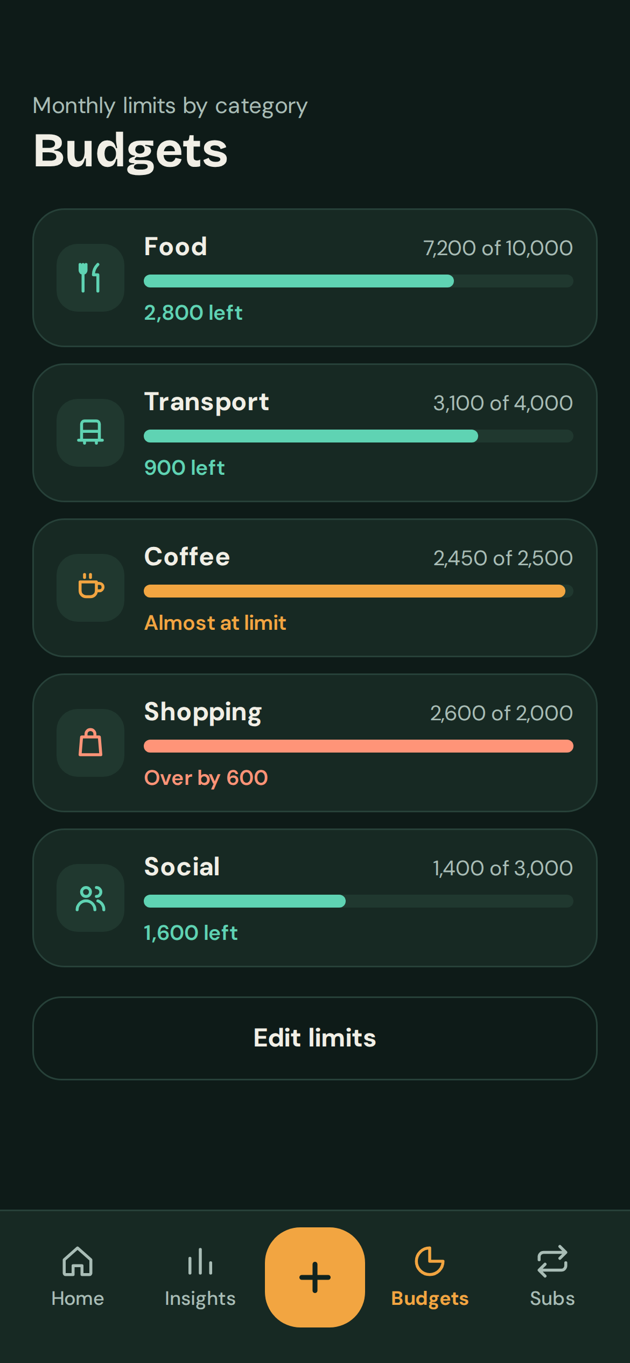
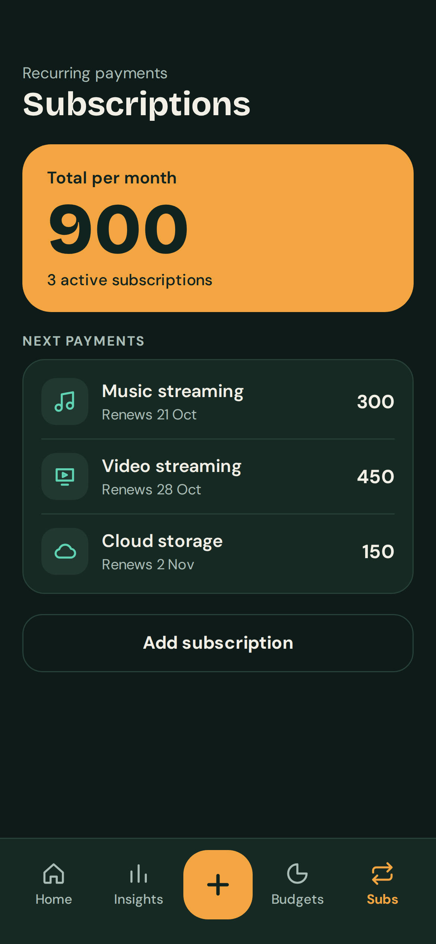
The app screens
Home
Quick add
Insights
Budgets
Subscriptions
Notes:
These are the five screens of our prototype: the home screen with the daily figure, quick add, insights, budgets and subscriptions. All numbers are sample data.

Slide 8
How the app is structured
SCREENS (BOTTOM TABS)
Home
daily figure
Quick add
5-second log
Insights
category totals
Budgets
monthly limits
Subscriptions
recurring costs
reads
writes
reads
reads, writes
reads, writes
LOCAL DATA STORE (ON THE PHONE)
Expenses
Category budgets
Subscriptions
Allowance + settings
No login and no bank connection: all data stays on the phone.
Notes:
The app has five screens. Home and insights only read data. Quick add, budgets and subscriptions also save what the student enters. Everything is stored on the phone, so there is no login and no bank connection.

Slide 9
The process
1
2
3
4
Read the brief
Shape the concept
Build the prototype
Prepare the pitch
Claude explained the task and split it into understand, control, manage.
Claude proposed the name, user and features. We chose what to keep.
Claude wrote the build prompt and designed the app screens.
Claude drafted these slides. We edited them and wrote the script.
Our decisions: [what your group changed, and why]
Notes:
We used an LLM as a partner at every stage. It generated options and we made the decisions. Mention one or two things the group changed from Claude's first suggestions and why.

Slide 10
Know how much you can spend today without running out before the month ends.
POCKET PATH IN ONE SENTENCE
Thank you. Questions?
Notes:
That is Pocket Path: it shows students where their small daily spending goes and tells them what they can safely spend today. Thank you, we are happy to take questions.

